Slide 1
OS ARCHITECTURE
Outline (continued)
Operating System Architectures and Types of Operating System
Monolithic Architecture
Layered Architecture
Microkernel Architecture
Networked and Distributed Operating Systems

Slide 2
Operating System Architectures
Today’s operating systems tend to be complex
  Provide many services
  Support variety of hardware and software
  Operating system architectures help manage this complexity
    Organize operating system components
    Specify privilege with which each component executes

Slide 3
Monolithic Architecture
Monolithic operating system
  Every component contained in kernel
    Any component can directly communicate with any other
  Tend to be highly efficient
  Disadvantage is difficulty determining source of subtle errors

Slide 4
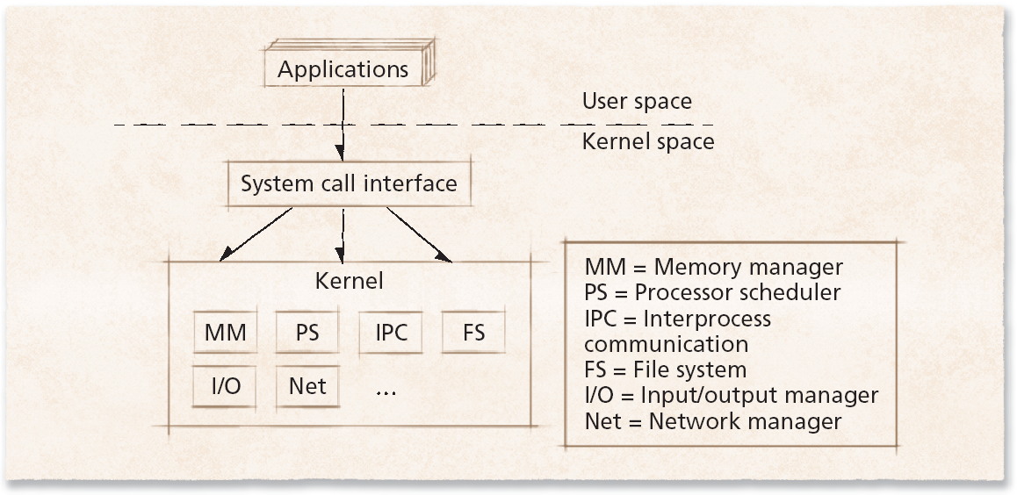
Monolithic Architecture
Figure Monolithic operating system kernel architecture.

Slide 5
Layered Architecture
Layered approach to operating systems
  Tries to improve on monolithic kernel designs
    Groups components that perform similar functions into layers
  Each layer communicates only with layers immediately above and below it
  Processes’ requests might pass through many layers before completion
  System throughput can be less than monolithic kernels
    Additional methods must be invoked to pass data and control

Slide 6
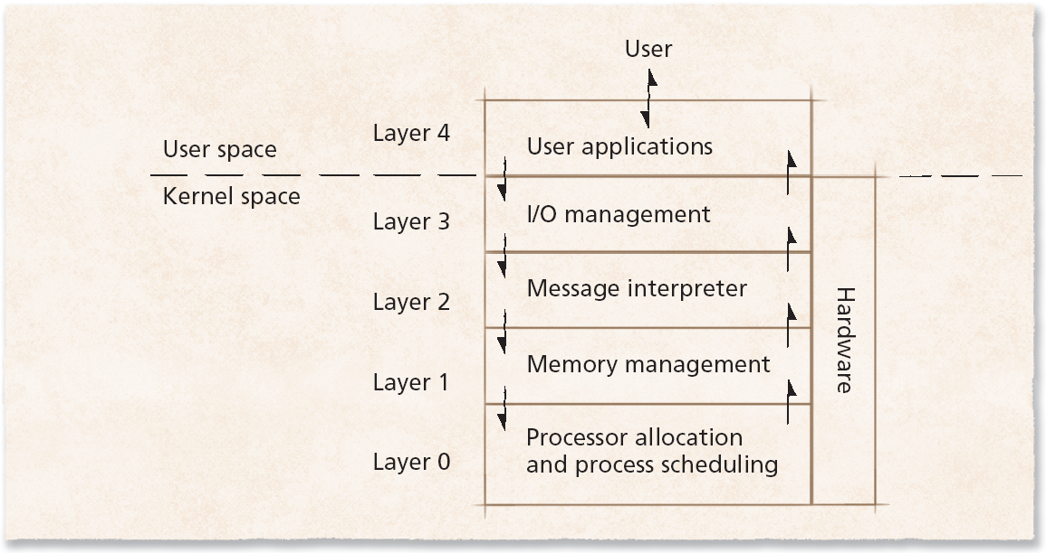
Layered Architecture
Figure Layers of the operating system.

Slide 7
Microkernel Architecture
Microkernel operating system architecture
  Provides only small number of services
    Attempt to keep kernel small and scalable
  High degree of modularity
    Extensible, portable and scalable
  Increased level of intermodule communication
    Can degrade system performance

Slide 8
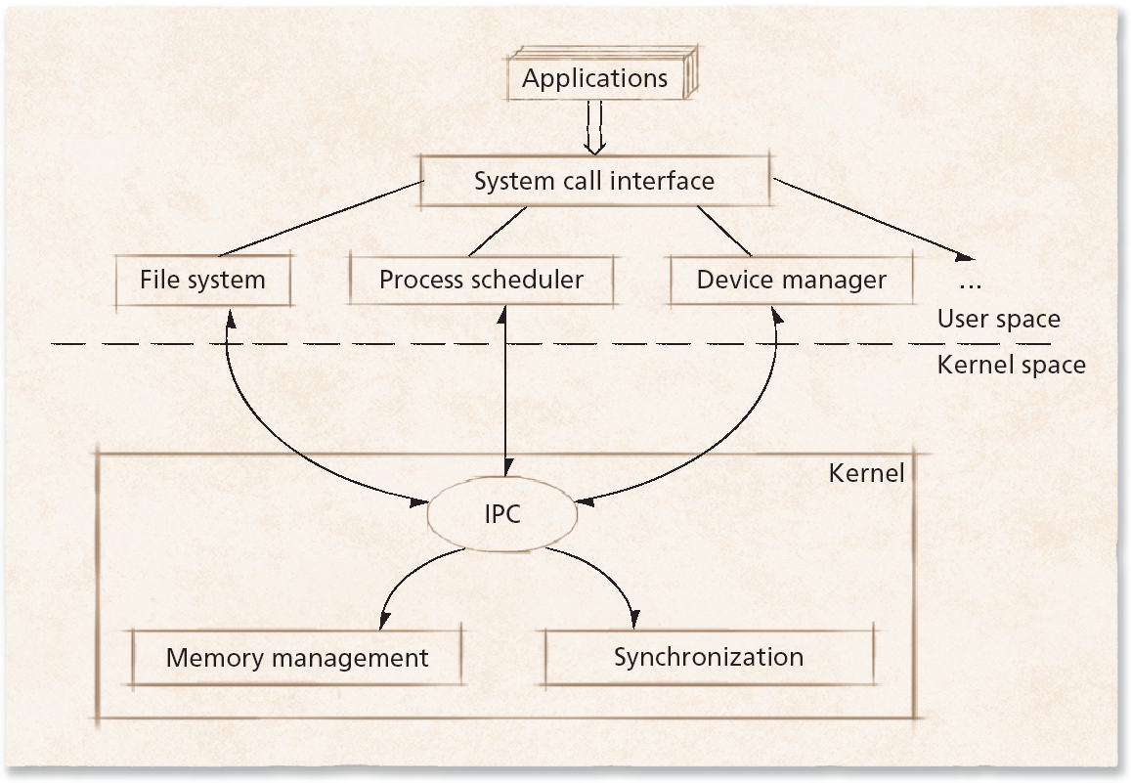
Microkernel Architecture
Figure Microkernel operating system architecture.

Slide 9
Networked and Distributed Operating Systems
Network operating system
  Runs on one computer
  Allows its processes to access resources on remote computers
Distributed operating system
  Single operating system
  Manages resources on more than one computer system
  Goals include:
    Transparent performance
    Scalability
    Fault tolerance
    Consistency

Slide 10
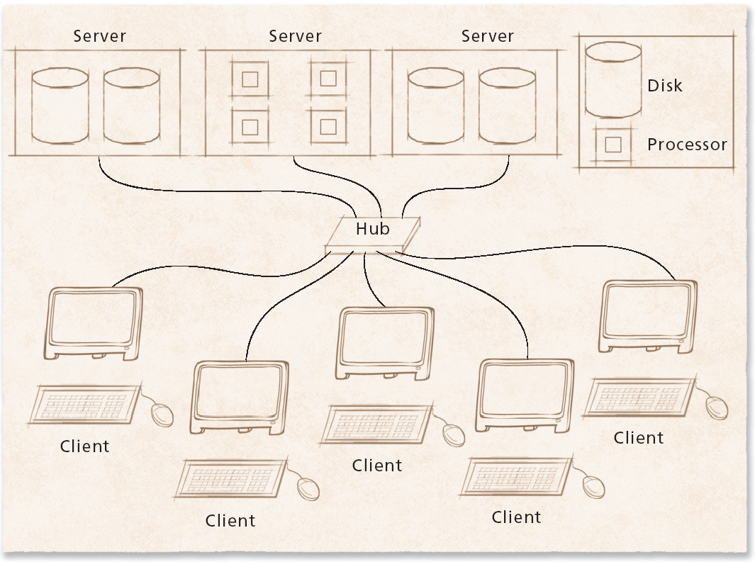
1.13.4 Networked and Distributed Operating Systems
Figure 1.6 Client/server networked operating system model.

